Slide 1
Odometry
How to win Control Award
Notes:
Keerik

Slide 2
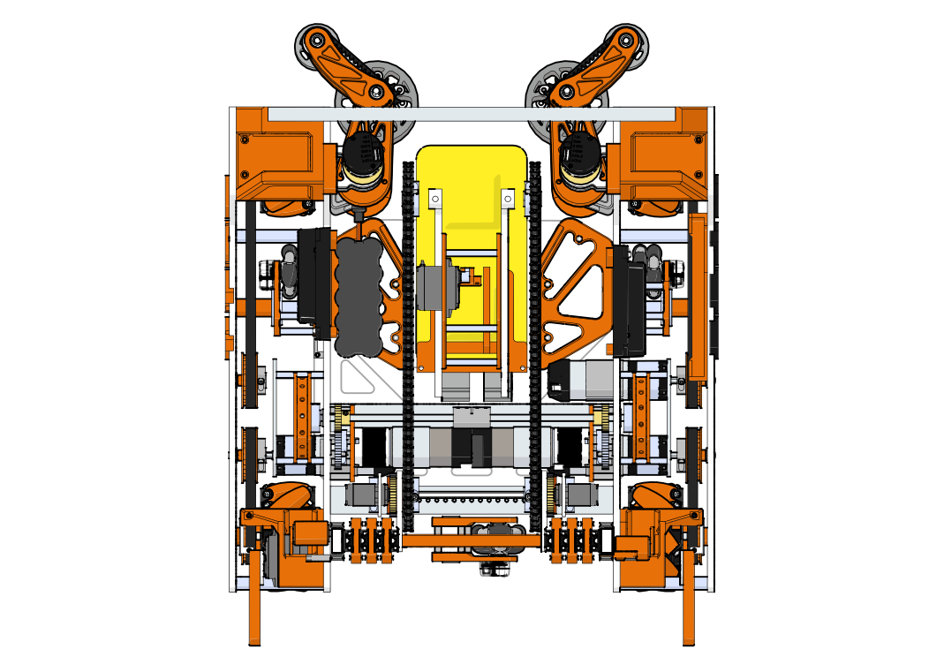
What is Odometry?
Uses non-powered omni wheels to track robot position and heading
Red: Forward facing wheels
Tracks forwards/backwards movement and rotation
Blue: Sideways facing wheel
Tracks strafing
Advantages over using IMU and motor encoders
No wheel slippage
IMU read times are long
Disadvantages
Becomes inaccurate if wheels lose contact

Slide 3
Part 1: Derivation

Slide 4
Types of Movement
Forwards/Backwards line
Forwards/Backwards arc
Diagonal line
Strafing line
Strafing arc

Slide 5
Simplification 1: Treat Lines as Arcs
Forwards/Backwards line
Forwards/Backwards arc
Diagonal line
Strafing line
Strafing arc

Slide 6
Simplification 2: Split Into Components
Forwards/
Backwards component
Only Forwards/Backwards
Forwards/Backwards arc
Diagonal line
Has components of both
Strafing component
Only Strafing
Strafing arc

Slide 7
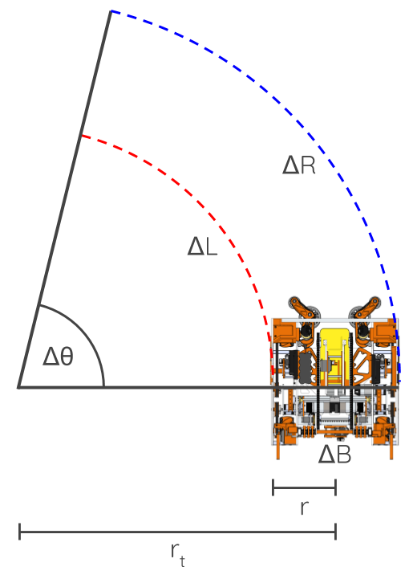
Forwards/Backwards Derivation: Heading
$$∆L=\left(r_{t}−r\right)∆θ$$
$$∆R=\left(r_{t}+r\right)∆θ$$
$$∆R−∆L=\left(r_{t}+r\right)∆θ−\left(r_{t}−r\right)∆θ$$
$$∆R−∆L=r_{t}∆θ+r∆θ−r_{t}∆θ+r∆θ$$
$$∆R−∆L=2r∆θ$$
$$∆θ=\frac{∆R−∆L}{2r}$$

Slide 8
Forwards/Backwards Derivation: Radius
$$∆L=\left(r_{t}−r\right)∆θ$$
$$∆R=\left(r_{t}+r\right)∆θ$$
$$∆θ=\frac{∆L}{r_{t}−r}$$
$$∆θ=\frac{∆R}{r_{t}+r}$$
$$\frac{∆L}{r_{t}−r}=\frac{∆R}{r_{t}+r}$$

Slide 9
Forwards/Backwards Derivation: Radius
$$\frac{∆L}{r_{t}−r}=\frac{∆R}{r_{t}+r}$$
$$∆Lr_{t}+∆Lr=∆Rr_{t}−∆Rr$$
$$∆Lr_{t}−∆Rr_{t}=∆Lr+∆Rr$$
$$r_{t}\left(∆L−∆R\right)=r\left(∆L+∆R\right)$$
$$r_{t}=\frac{r\left(∆L+∆R\right)}{∆L−∆R}$$

Slide 10
Forwards/Backwards Derivation: Final
$$∆θ=\frac{∆R−∆L}{2r}$$
$$r_{t}=\frac{r\left(∆L+∆R\right)}{∆L−∆R}$$
$$∆x=r_{t}(\cos{∆θ}−1)$$
$$∆y=r_{t}\sin{∆θ}$$

Slide 11
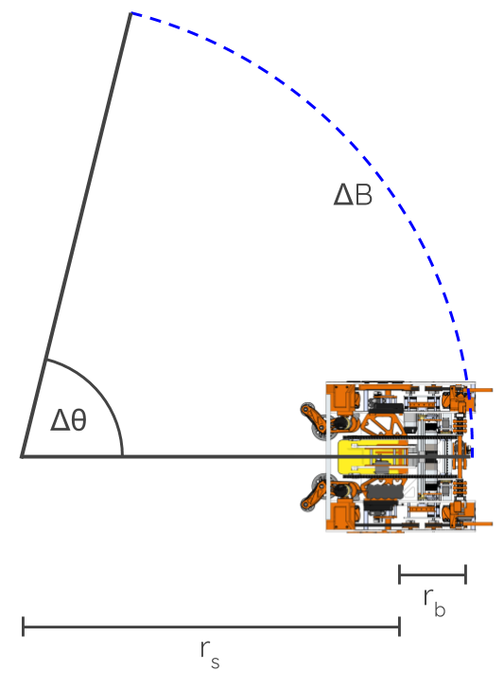
Strafing Derivation: Heading
The forwards/backwards heading equation works here as well, so no need to make a new one.
$$∆θ=\frac{∆R−∆L}{2r}$$

Slide 12
Strafing Derivation: Radius
$$∆B=(r_{s}+r_{b})∆θ$$
$$∆B=r_{s}∆θ+r_{b}∆θ$$
$$r_{s}∆θ=∆B−r_{b}∆θ$$
$$r_{s}=\frac{∆B}{∆θ}−r_{b}$$

Slide 13
Strafing Derivation: Final
$$∆θ=\frac{∆R−∆L}{2r}$$
$$r_{s}=\frac{∆B}{∆θ}−r_{b}$$
x
$$∆x=r_{s}\sin{∆θ}$$
$$∆y=r_{s}(1−cos{∆θ})$$
y
Because the robot is facing sideways, the sin and cos are switched.

Slide 14
Final Equations
$$∆θ=\frac{∆R−∆L}{2r}$$
If Δθ = 0:
$$∆x=∆B$$
$$∆y=\frac{∆L+∆R}{2}$$
If Δθ ≠ 0:
$$r_{t}=\frac{r\left(∆L+∆R\right)}{∆L−∆R}$$
$$r_{s}=\frac{∆B}{∆θ}−r_{b}$$
$$∆x=r_{t}\left(\cos{∆θ}−1\right)+r_{s}\sin{∆θ}$$
$$∆y=r_{t}\sin{∆θ}+r_{s}(1−cos{∆θ})$$
The forwards/backwards and strafing components are added together.

Slide 15
Adding onto Current Position
Calculate the change in position $\overset{⃑}{∆s}$ using the equations.
The vector $\overset{⃑}{∆s}$ is relative to the robot, so rotate it based on the robot’s previous heading. to make it relative to the field
Add $\overset{⃑}{∆s}$ to the robot location vector $\overset{⃑}{s}$.
Repeat after the next loop.
$$∆y$$
$$\overset{⃑}{∆s}$$
$$∆x$$
$$\overset{⃑}{s_{1}}$$
$$\overset{⃑}{s_{0}}$$

Slide 16
Part 2: Implementation

Slide 17
Wiring
Odometry wheel encoders replace drive motor encoders
lEncoder
lFront
rEncoder
lBack
rFront
bEncoder
rBack

Slide 18
Coding
Make an instance of DcMotor for each odometry encoder
Have each one point to the motor whose encoder port it is using
Drive motors have to be run using RUN_WITHOUT_ENCODER now
Use current and previous encoder data of each motor in equations
DcMotor lEncoder = lFront;
DcMotor rEncoder = lBack;
DcMotor bEncoder = rFront;
lFront.setMode(DcMotor.RunMode.RUN_WITHOUT_ENCODER);
rFront.setMode(DcMotor.RunMode.RUN_WITHOUT_ENCODER);
lBack.setMode(DcMotor.RunMode.RUN_WITHOUT_ENCODER);
rBack.setMode(DcMotor.RunMode.RUN_WITHOUT_ENCODER);
deltalEncoder = getlEncoderCounts() - lEncoderPrevious;
deltarEncoder = getrEncoderCounts() - rEncoderPrevious;
deltabEncoder = getbEncoderCounts() - bEncoderPrevious;
//equations go here
lEncoderPrevious = getlEncoderCounts();
rEncoderPrevious = getrEncoderCounts();
bEncoderPrevious = getbEncoderCounts();

Slide 19
Making Odometry Better: Software
Sync heading data with IMU once in a while
Last season, we synced every 50 loop iterations
Experimentally tune wheel radii
Ex. Rotate the robot in place 10 times, solve for radii using odometry encoder data
Use bulk reads and tune your loop cycles to be as fast as possible
The faster your loop speeds are, the more accurate your estimate is

Slide 20
Making Odometry Better: Hardware
Place wheels as far as possible for robot center
Make sure that odometry pods are rigid and don’t flex at all
Ensure all odometry pods are square with one another
Forwards-facing pods are exactly parallel, sideways-facing pod is exactly perpendicular
Try to eliminate backlash or friction in the system
Make sure the odometry wheel itself is properly constrained so it doesn’t slide left/right at all
Ensure proper tension in the springs

